Slide 1
Employee Data Analysis using Excel
STUDENT NAME : HARIPRIYA .S
REGISTER NO : Unm410100442213371036211
(2213371036211)
DEPARTMENT : COMMERCE
COLLEGE : QUAID E MILLATH GOVERNMENT
COLLEGE FOR WOMEN CHENNAI-02.

Slide 2
PROJECT TITLE
Employee Performance Analysis using Excel

Slide 3


AGENDA
Problem Statement
Project Overview
End Users
Our Solution and Proposition
Dataset Description
Modelling Approach
Results and Discussion
Conclusion
3/21/2024 Annual Review

Slide 4

PROBLEM STATEMENT
1. **Define the Purpose:**
- **Objective:** What specific goals do you aim to achieve with the employee data analysis? For example, are you looking to improve employee retention, enhance performance, or optimize staffing levels?
- **Example Purpose:** "The goal is to identify factors contributing to high employee turnover rates to develop strategies for retention and improve overall job satisfaction."
2. **Identify the Data Sources:**
- **Types of Data:** Determine what types of data are available and relevant, such as employee demographics, performance metrics, attendance records, and feedback surveys.
- **Example Data Sources:** "We will use data from HR systems, performance review databases, and employee surveys."

Slide 5

PROJECT OVERVIEW
**1. Project Title:**Eff
**Employee Data Analysis for Improved Organizational effectiveness
### **2. Project Background:**
- **Context:** In today's competitive business environment, understanding employee dynamics is crucial for optimizing organizational performance and employee satisfaction. Effective data analysis can uncover insights into turnover rates, performance trends, and employee engagement, providing a foundation for data-driven decision-making.
- **Current Situation:** The organization is facing challenges related to high employee turnover, varying performance levels, and fluctuating employee satisfaction scores. This project aims to address these issues through comprehensive data analysis.
### **3. Objectives:**
- **Primary Objective:** To analyze employee data to identify patterns, trends, and factors influencing turnover and performance, leading to actionable insights for improving organizational effectiveness.
.

Slide 6

WHO ARE THE END USERS?
1. **HR Professionals:** Utilize insights to improve recruitment processes, manage talent, and develop employee retention strategies.
2. **Managers and Team Leaders:** Leverage data to assess team performance, identify areas for development, and make decisions on training and promotions.
3. **Executives and Senior Leadership:** Use findings to shape organizational strategy, optimize workforce planning, and drive overall business performance.
4. **Organizational Development Specialists:** Apply data to design and implement initiatives that enhance employee engagement, satisfaction, and career growth.
5. **Compensation and Benefits Analysts:** Analyze data to ensure competitive and equitable compensation structures and to adjust benefits offerings based on employee needs and market trends.

Slide 7

OUR SOLUTION AND ITS VALUE PROPOSITION
1. **Enhanced Recruitment Processes**
- **Solution**: Use data analysis to identify traits and qualifications of high-performing employees, streamline the recruitment process, and improve the accuracy of candidate selection.
- **Value Proposition**: This reduces turnover rates and ensures that new hires are better suited to the company culture and job requirements, leading to increased productivity and cost savings in hiring.
2. **Improved Employee Retention**
- **Solution**: Analyze patterns in employee tenure, engagement levels, and feedback to pinpoint factors contributing to employee dissatisfaction and turnover.
- **Value Proposition**: By addressing these issues proactively, companies can enhance job satisfaction and loyalty, reducing recruitment and training costs and fostering a more stable workforce.

Slide 8
Dataset Description
1. **Data Structure and Organization**
- **Description**: Clearly define the layout of your Excel worksheet, including columns for employee ID, names, job titles, departments, hire dates, performance ratings, and other relevant metrics.
2. **Data Types and Formats**
- **Description**: Specify the types of data in each column, such as text (employee names, job titles), numbers (salaries, performance scores), dates (hire dates, review dates), and categorical data (departments, job levels). Use appropriate Excel data formats (e.g., date format for hire dates).
3. **Data Validation and Accuracy**
- **Description**: Implement data validation rules to ensure data entry is consistent and accurate. This can include drop-down lists for categorical data, range checks for numeric values, and mandatory fields.

Slide 9

THE "WOW" IN OUR SOLUTION
PERFORMANCE LEVEL=IF(Z8>=5, “VERY HIGH”, IF(Z8>=4,”HIGH”, IF(Z8>=3,”MEDIUM”, “LOW”)))
3/21/2024 Annual Review
9

Slide 10
MODELLING
To effectively model employee data for analysis, follow these steps:
1. **Organize Data**: Structure your dataset with clear columns for Employee ID, Department, Job Title, Hire Date, Performance Rating, Salary, and any other relevant fields.
2. **Clean Data**: Ensure accuracy by removing duplicates, handling missing values, and standardizing formats.
3. **Transform Data**: Create new variables like employee tenure and performance bands to enhance analysis.
4. **Apply Descriptive and Predictive Techniques**: Use statistical summaries, trend analysis, and predictive models to derive insights, such as turnover rates or salary trends.
5. **Visualize Results**: Use pivot tables, charts, and dashboards to present findings clearly, allowing for easy interpretation and data-driven decision-making.
10

Slide 11
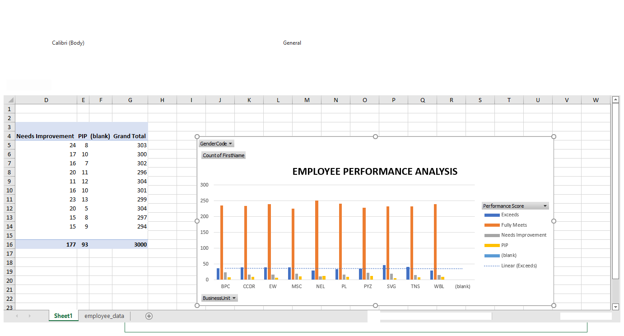
RESULTS
11

Slide 12
conclusion
**Conclusion**
In reviewing the performance of employees over the past evaluation period, several key insights have emerged:
1. **Strengths and Achievements:** Employees have demonstrated significant strengths in areas such as [specific skill or behavior], which has contributed to [specific outcomes, e.g., increased productivity, enhanced team collaboration]. Notably, [employee name or team] excelled in [specific task or project], showcasing their ability to [specific achievement].
2. **Areas for Improvement:** Despite these strengths, there are identifiable areas for improvement. Specifically, [describe areas, e.g., time management, communication] have shown variability and present opportunities for development. Addressing these areas could lead to improved performance and overall team effectiveness.
3. **Impact on Organizational Goals:** The performance of the employees has had a [positive/negative] impact on the organization’s strategic goals. For instance, [describe impact] has aligned well with [organizational goals], while [specific issues] have highlighted the need for [change or intervention].

